Slide 1
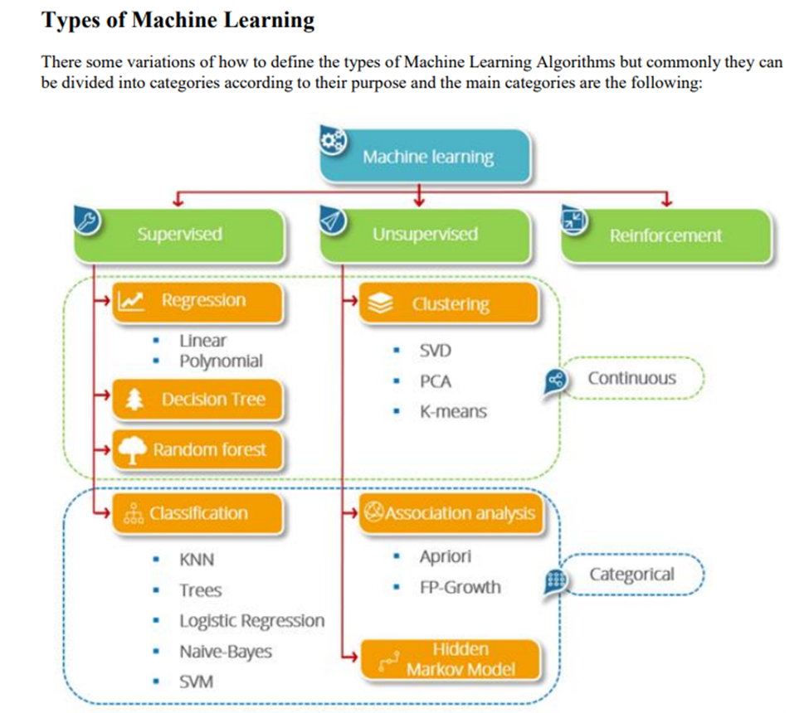

Slide 2
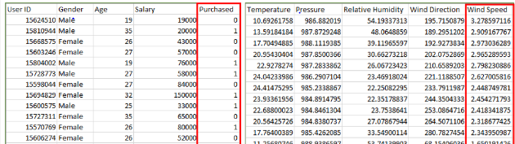
Supervised Learning:

Slide 3
Types of Supervised Learning:
  Classification
  Regression

Slide 4
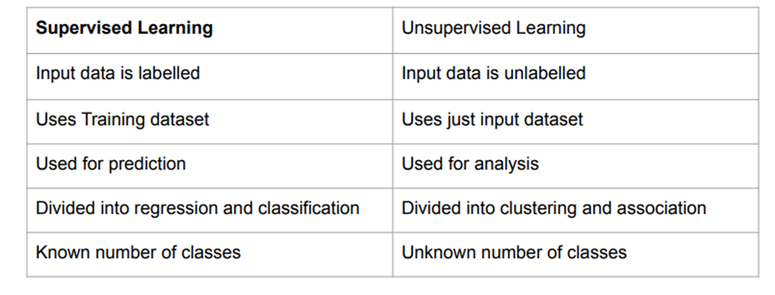

Slide 5
Types of Unsupervised Learning:
  Clustering
  Association

